Slide 1
Autonomous Vehicle Cybersecurity Development Lifecycle (AVCDL)
Charles Wilson
Principal Engineer, Cybersecurity Development Lifecycle Practice
version 4
2022-02-22

Slide 2

Speaker Bio
Charles is a Principal Engineer at Motional responsible for developing their cybersecurity development lifecycle practice. He has over 37 years of professional experience across a broad range of domains including aerospace, publishing, software development, technical illustrations, networking, embedded wireless hardware and software, distributed image scaling, enterprise scale distributed systems, medical devices, and autonomous vehicles. He first worked on security software in 1983. He holds a BSCS (Computer Science), MSEE (Electrical and Computer Engineering), and is CSSLP certified. His masters work in 1992 was in anti-viral computer architecture. He has been threat modeling for over 10 years. Charles has participated on several ISO standards committees. His most recent activities included staffing at the FDA/MITRE/MDIC medical device threat modeling training bootcamps and working on the development ISO/SAE 21434 (Road vehicles — Cybersecurity engineering) and its related standards. He is the vice-chair of the SAE Cybersecurity Maturity Model Task Force (TEVEES18A3). He is the primary author and editor of the Autonomous Vehicle Cybersecurity Development Lifecycle (AVCDL).

Slide 3
ISO/SAE 21434 is Here
Road Vehicles – Cybersecurity Engineering

Slide 4
How Will We Attain Compliance?
?

Slide 5
Autonomous Vehicle Cybersecurity Development Lifecycle

Slide 6
Lifecycle Basics
Policy
Why

Slide 7
Lifecycle Basics
Policy
Why
Process
What / Who / When

Slide 8
Lifecycle Basics
Policy
Why
Process
What / Who / When
Procedure
How

Slide 9
Lifecycle Basics
Policy
Why
Lifecycle
Process
What / Who / When
Procedure
How

Slide 10
Lifecycles Have Assumptions
ISO 15288 System Development Life Cycle (SDLC)
ISO 12207 Software Development Life Cycle (SDLC)
ISO 26262 Road Vehicles - Functional Safety
ISO 21434 Road Vehicles - Cybersecurity Engineering
UNECE WP.29 R155 Cyber Security Management Systems (CSMS)

Slide 11
How the Standards Line Up
AVPDL | 15288 (SDLC system) | 12207 (SDLC software) | 26262 (safety) | 21434 (cybersecurity)
organization processes | technical processes | technical processes | management of functional safety | overall cybersecurity management
 |  |  | supporting processes | project dependent cybersecurity management
foundation phase | N/A | N/A | concept phase | concept
requirements phase | requirements definition | requirements definition | safety requirements | cybersecurity requirements
 | requirements analysis | system requirements analysis | hazard analysis / risk assessment | cybersecurity assessment
design phase | architectural design | system architectural design | architectural design | cybersecurity design
implementation phase | implementation | implementation | implementation | development
 | integration | system integration | integration and verification | integration and verification
verification phase | verification | system qualification testing
 | transition | software installation
 |  | software acceptance support
release phase | validation |  | production | production
operation phase | operation | software operation | operation, service and decommissioning | continuous cybersecurity activities
 | maintenance | software maintenance |  | operation and maintenance
decommissioning phase | disposal | software disposal |  | decommissioning
supplier processes | agreement processes | agreement processes | supporting processes | distributed cybersecurity activities

Slide 12
How the Standards Line Up
AVPDL | 15288 (SDLC system) | 12207 (SDLC software) | 26262 (safety) | 21434 (cybersecurity)
organization processes | technical processes | technical processes | management of functional safety | overall cybersecurity management
 |  |  | supporting processes | project dependent cybersecurity management
foundation phase | N/A | N/A | concept phase | concept
requirements phase | requirements definition | requirements definition | safety requirements | cybersecurity requirements
 | requirements analysis | system requirements analysis | hazard analysis / risk assessment | cybersecurity assessment
design phase | architectural design | system architectural design | architectural design | cybersecurity design
implementation phase | implementation | implementation | implementation | development
 | integration | system integration | integration and verification | integration and verification
verification phase | verification | system qualification testing
 | transition | software installation
 |  | software acceptance support
release phase | validation |  | production | production
operation phase | operation | software operation | operation, service and decommissioning | continuous cybersecurity activities
 | maintenance | software maintenance |  | operation and maintenance
decommissioning phase | disposal | software disposal |  | decommissioning
supplier processes | agreement processes | agreement processes | supporting processes | distributed cybersecurity activities

Slide 13
How the Standards Line Up
AVPDL | 15288 (SDLC system) | 12207 (SDLC software) | 26262 (safety) | 21434 (cybersecurity)
organization processes | technical processes | technical processes | management of functional safety | overall cybersecurity management
 |  |  | supporting processes | project dependent cybersecurity management
foundation phase | N/A | N/A | concept phase | concept
requirements phase | requirements definition | requirements definition | safety requirements | cybersecurity requirements
 | requirements analysis | system requirements analysis | hazard analysis / risk assessment | cybersecurity assessment
design phase | architectural design | system architectural design | architectural design | cybersecurity design
implementation phase | implementation | implementation | implementation | development
 | integration | system integration | integration and verification | integration and verification
verification phase | verification | system qualification testing
 | transition | software installation
 |  | software acceptance support
release phase | validation |  | production | production
operation phase | operation | software operation | operation, service and decommissioning | continuous cybersecurity activities
 | maintenance | software maintenance |  | operation and maintenance
decommissioning phase | disposal | software disposal |  | decommissioning
supplier processes | agreement processes | agreement processes | supporting processes | distributed cybersecurity activities

Slide 14
How the Standards Line Up
AVPDL | 15288 (SDLC system) | 12207 (SDLC software) | 26262 (safety) | 21434 (cybersecurity)
organization processes | technical processes | technical processes | management of functional safety | overall cybersecurity management
 |  |  | supporting processes | project dependent cybersecurity management
foundation phase | N/A | N/A | concept phase | concept
requirements phase | requirements definition | requirements definition | safety requirements | cybersecurity requirements
 | requirements analysis | system requirements analysis | hazard analysis / risk assessment | cybersecurity assessment
design phase | architectural design | system architectural design | architectural design | cybersecurity design
implementation phase | implementation | implementation | implementation | development
 | integration | system integration | integration and verification | integration and verification
verification phase | verification | system qualification testing
 | transition | software installation
 |  | software acceptance support
release phase | validation |  | production | production
operation phase | operation | software operation | operation, service and decommissioning | continuous cybersecurity activities
 | maintenance | software maintenance |  | operation and maintenance
decommissioning phase | disposal | software disposal |  | decommissioning
supplier processes | agreement processes | agreement processes | supporting processes | distributed cybersecurity activities

Slide 15
How the Standards Line Up
AVPDL | 15288 (SDLC system) | 12207 (SDLC software) | 26262 (safety) | 21434 (cybersecurity)
organization processes | technical processes | technical processes | management of functional safety | overall cybersecurity management
 |  |  | supporting processes | project dependent cybersecurity management
foundation phase | N/A | N/A | concept phase | concept
requirements phase | requirements definition | requirements definition | safety requirements | cybersecurity requirements
 | requirements analysis | system requirements analysis | hazard analysis / risk assessment | cybersecurity assessment
design phase | architectural design | system architectural design | architectural design | cybersecurity design
implementation phase | implementation | implementation | implementation | development
 | integration | system integration | integration and verification | integration and verification
verification phase | verification | system qualification testing
 | transition | software installation
 |  | software acceptance support
release phase | validation |  | production | production
operation phase | operation | software operation | operation, service and decommissioning | continuous cybersecurity activities
 | maintenance | software maintenance |  | operation and maintenance
decommissioning phase | disposal | software disposal |  | decommissioning
supplier processes | agreement processes | agreement processes | supporting processes | distributed cybersecurity activities

Slide 16
AVPDL – Autonomous Vehicle Product Development Lifecycle
AVPDL | 15288 (SDLC system) | 12207 (SDLC software) | 26262 (safety) | 21434 (cybersecurity)
organization processes | technical processes | technical processes | management of functional safety | overall cybersecurity management
 |  |  | supporting processes | project dependent cybersecurity management
foundation phase | N/A | N/A | concept phase | concept
requirements phase | requirements definition | requirements definition | safety requirements | cybersecurity requirements
 | requirements analysis | system requirements analysis | hazard analysis / risk assessment | cybersecurity assessment
design phase | architectural design | system architectural design | architectural design | cybersecurity design
implementation phase | implementation | implementation | implementation | development
 | integration | system integration | integration and verification | integration and verification
verification phase | verification | system qualification testing
 | transition | software installation
 |  | software acceptance support
release phase | validation |  | production | production
operation phase | operation | software operation | operation, service and decommissioning | continuous cybersecurity activities
 | maintenance | software maintenance |  | operation and maintenance
decommissioning phase | disposal | software disposal |  | decommissioning
supplier processes | agreement processes | agreement processes | supporting processes | distributed cybersecurity activities

Slide 17
AVPDL – Autonomous Vehicle Product Development Lifecycle
AVPDL | 15288 (SDLC system) | 12207 (SDLC software) | 26262 (safety) | 21434 (cybersecurity)
organization processes | technical processes | technical processes | management of functional safety | overall cybersecurity management
 |  |  | supporting processes | project dependent cybersecurity management
foundation phase | N/A | N/A | concept phase | concept
requirements phase | requirements definition | requirements definition | safety requirements | cybersecurity requirements
 | requirements analysis | system requirements analysis | hazard analysis / risk assessment | cybersecurity assessment
design phase | architectural design | system architectural design | architectural design | cybersecurity design
implementation phase | implementation | implementation | implementation | development
 | integration | system integration | integration and verification | integration and verification
verification phase | verification | system qualification testing
 | transition | software installation
 |  | software acceptance support
release phase | validation |  | production | production
operation phase | operation | software operation | operation, service and decommissioning | continuous cybersecurity activities
 | maintenance | software maintenance |  | operation and maintenance
decommissioning phase | disposal | software disposal |  | decommissioning
supplier processes | agreement processes | agreement processes | supporting processes | distributed cybersecurity activities

Slide 18
AVPDL – Governance Processes
AVPDL | 15288 (SDLC system) | 12207 (SDLC software) | 26262 (safety) | 21434 (cybersecurity)
organization processes | technical processes | technical processes | management of functional safety | overall cybersecurity management
 |  |  | supporting processes | project dependent cybersecurity management
foundation phase | N/A | N/A | concept phase | concept
requirements phase | requirements definition | requirements definition | safety requirements | cybersecurity requirements
 | requirements analysis | system requirements analysis | hazard analysis / risk assessment | cybersecurity assessment
design phase | architectural design | system architectural design | architectural design | cybersecurity design
implementation phase | implementation | implementation | implementation | development
 | integration | system integration | integration and verification | integration and verification
verification phase | verification | system qualification testing
 | transition | software installation
 |  | software acceptance support
release phase | validation |  | production | production
operation phase | operation | software operation | operation, service and decommissioning | continuous cybersecurity activities
 | maintenance | software maintenance |  | operation and maintenance
decommissioning phase | disposal | software disposal |  | decommissioning
supplier processes | agreement processes | agreement processes | supporting processes | distributed cybersecurity activities

Slide 19
AVPDL – Lifecycle Phases
AVPDL | 15288 (SDLC system) | 12207 (SDLC software) | 26262 (safety) | 21434 (cybersecurity)
organization processes | technical processes | technical processes | management of functional safety | overall cybersecurity management
 |  |  | supporting processes | project dependent cybersecurity management
foundation phase | N/A | N/A | concept phase | concept
requirements phase | requirements definition | requirements definition | safety requirements | cybersecurity requirements
 | requirements analysis | system requirements analysis | hazard analysis / risk assessment | cybersecurity assessment
design phase | architectural design | system architectural design | architectural design | cybersecurity design
implementation phase | implementation | implementation | implementation | development
 | integration | system integration | integration and verification | integration and verification
verification phase | verification | system qualification testing
 | transition | software installation
 |  | software acceptance support
release phase | validation |  | production | production
operation phase | operation | software operation | operation, service and decommissioning | continuous cybersecurity activities
 | maintenance | software maintenance |  | operation and maintenance
decommissioning phase | disposal | software disposal |  | decommissioning
supplier processes | agreement processes | agreement processes | supporting processes | distributed cybersecurity activities

Slide 20
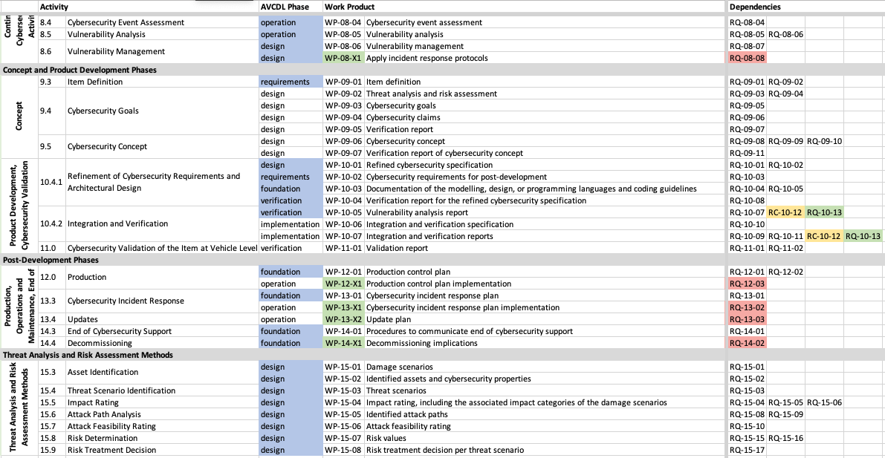
ISO 21434 Work Products and Requirements

Slide 21
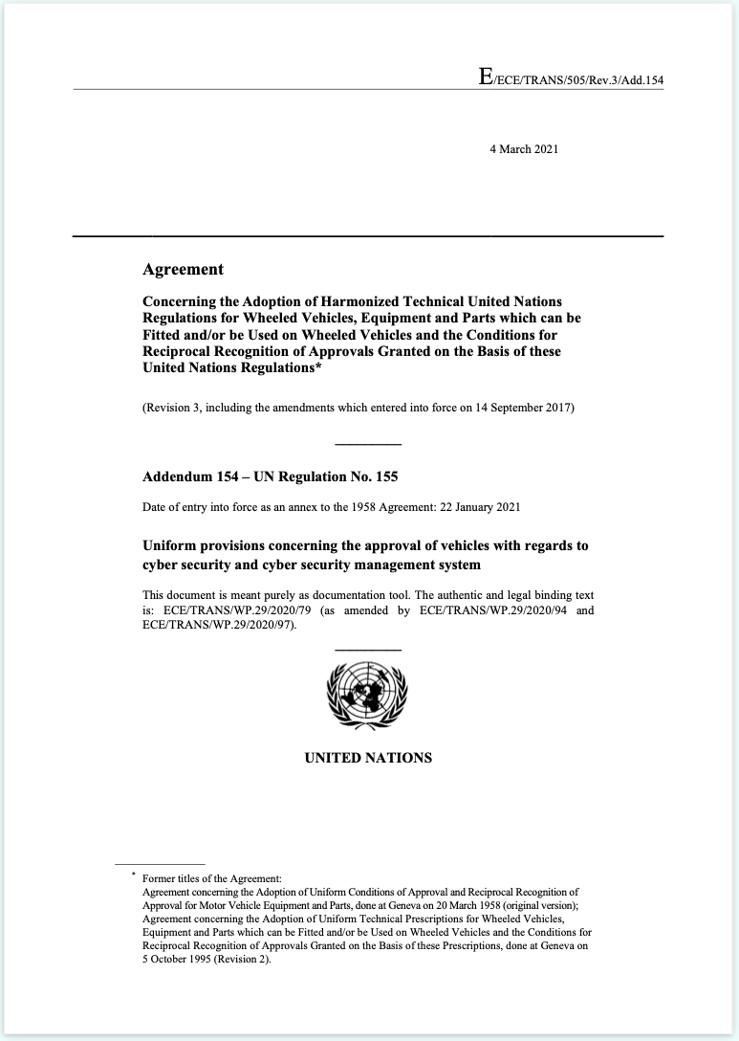
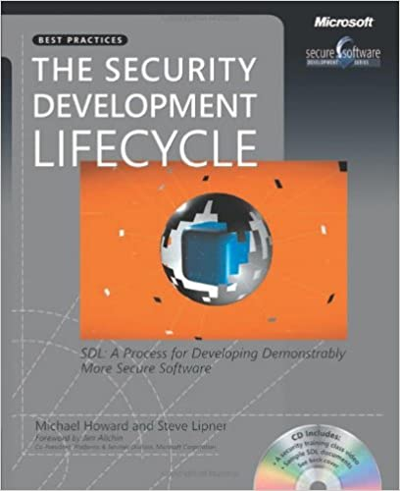
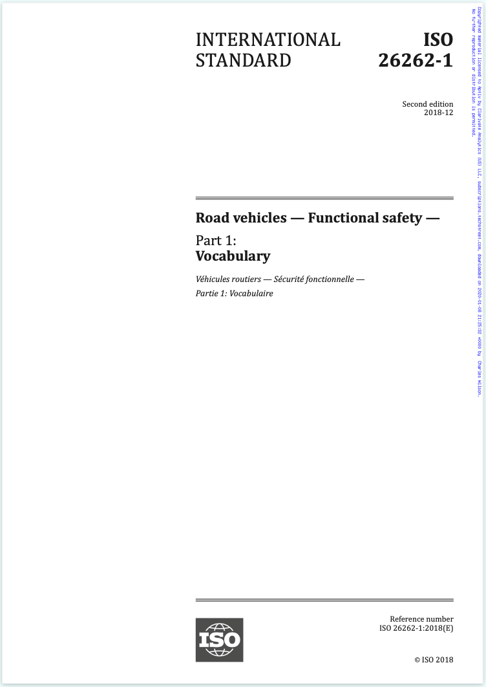
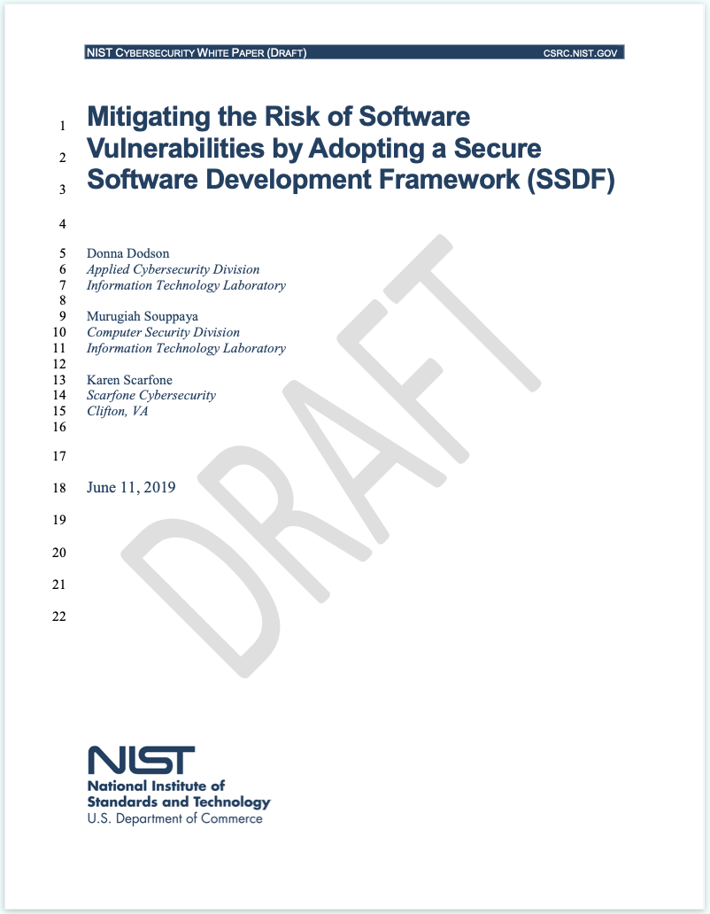
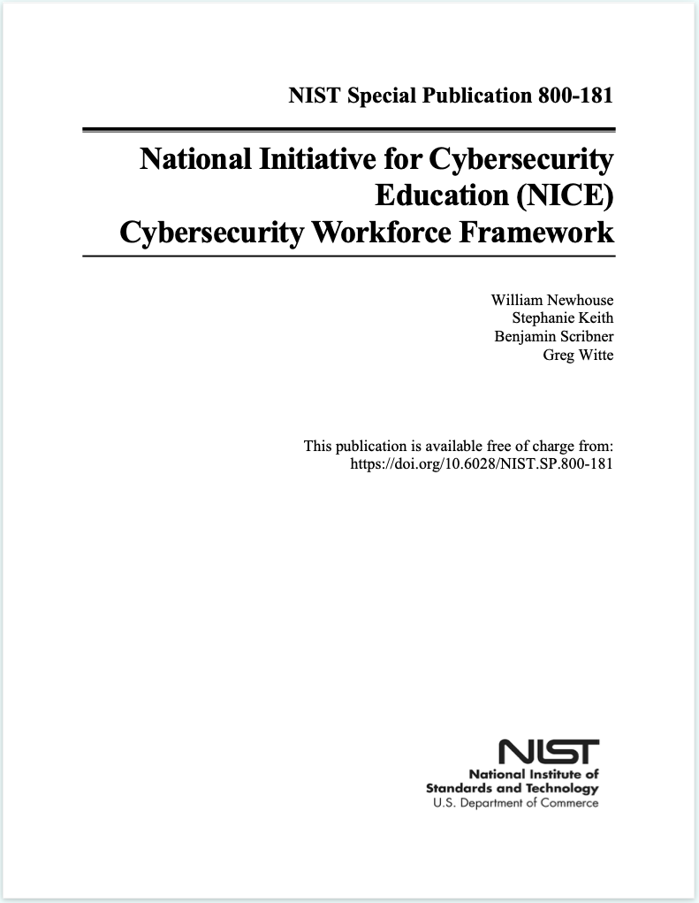
Reference Sources

Slide 22
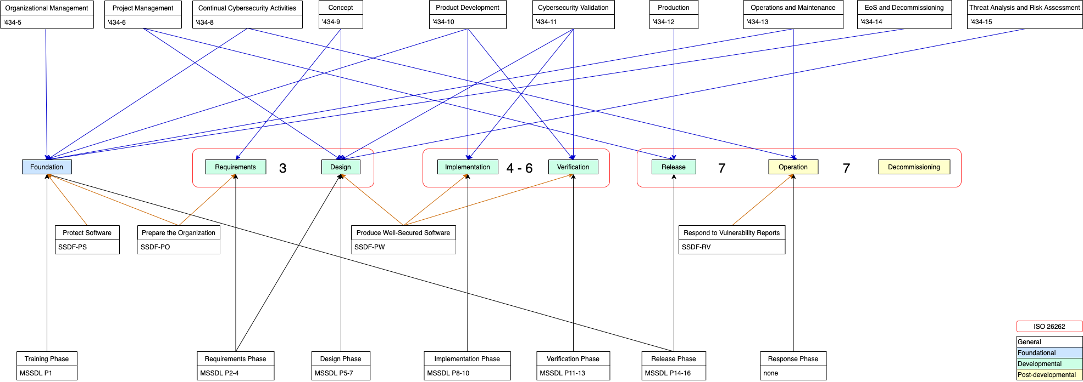
How Standards Inform the AVCDL

Slide 23
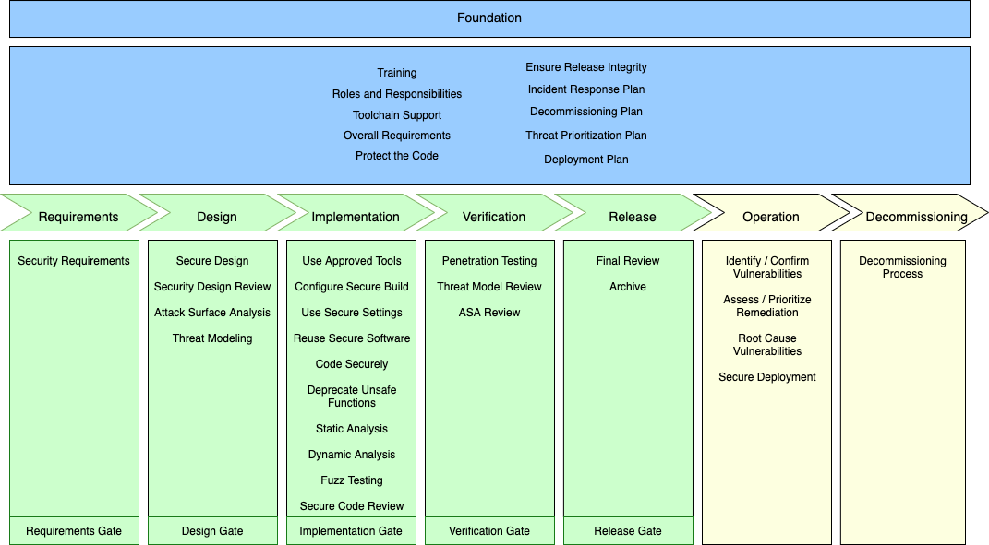
Phases and Requirements

Slide 24
Cyclic View
Release
Operation
Decommissioning
Foundation
Verification
Requirements
Implementation
Design

Slide 25
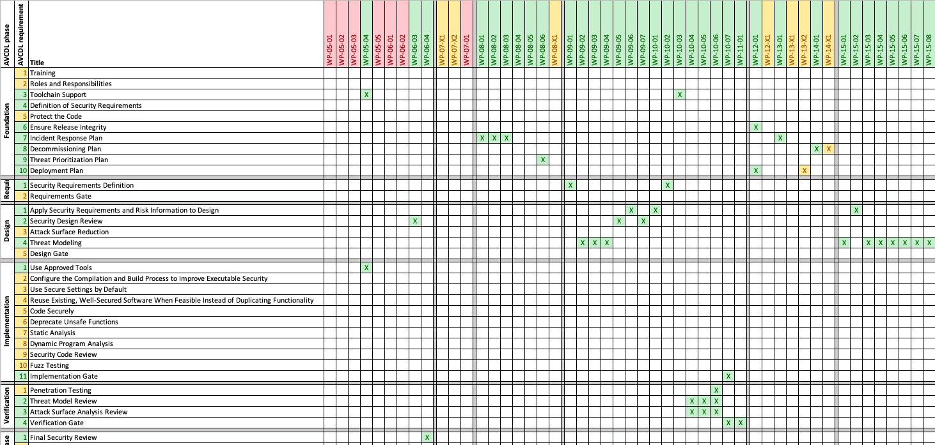
Compliance to Standards

Slide 26
Requirements / Roles / RACI / Dependent Inputs

Slide 27
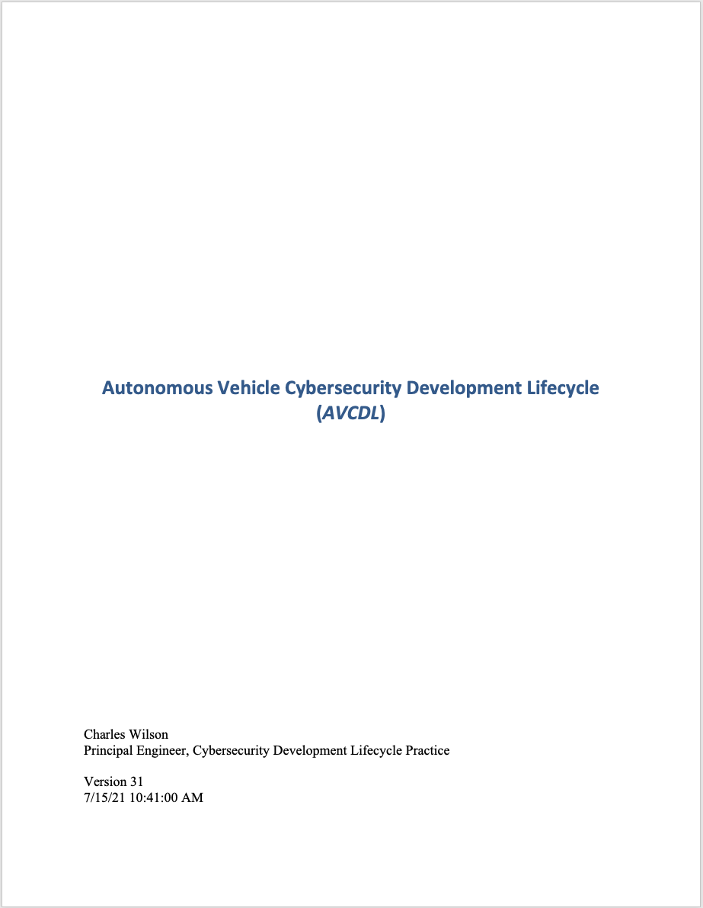
AVCDL Document Set
Process Overview
(primary)
Process Detail
(secondary)
Procedure
(tertiary)
Supporting Material
What / Who / When
(company agnostic)
How
(company specific)

Slide 28
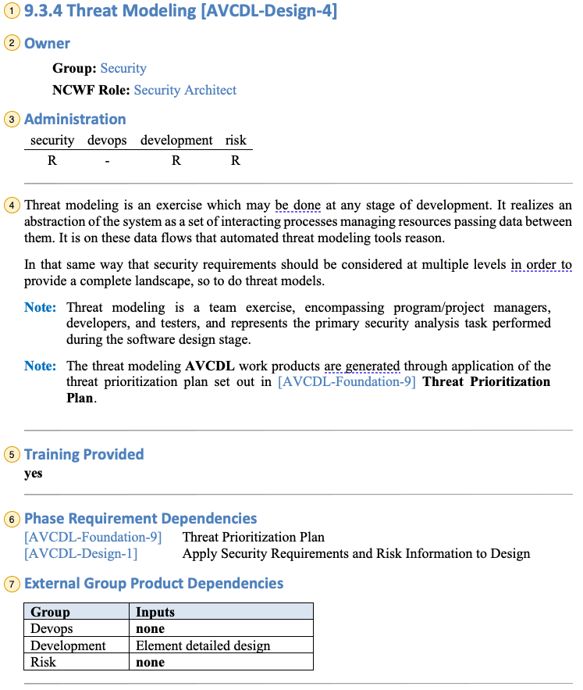
Phase Requirement Page Sample (1 of 2)
Item | Section | Description
 | Title | The title of the phase requirements and its ID. Each AVCDL phase requirement has a unique ID comprised of ‘AVCDL’, the phase (here ‘requirements’) and a sequence number.
 | Owner Group / Role | The group accountable for the activity and the NCWF role. These link to a summary of the particular group’s accountable phase requirements and the NIST SP 800-181 workforce job description.
 | RACI | RACI information for the various groups possibly involved in the activity
 | Description | A general description of the activity and its application
 | Training | Whether training is provided for the activity
 | Internal Dependencies | Predecessor AVCDL phase requirements
 | External Dependencies | Non-security group dependent materials
1
2
3
4
5
6
7

Slide 29
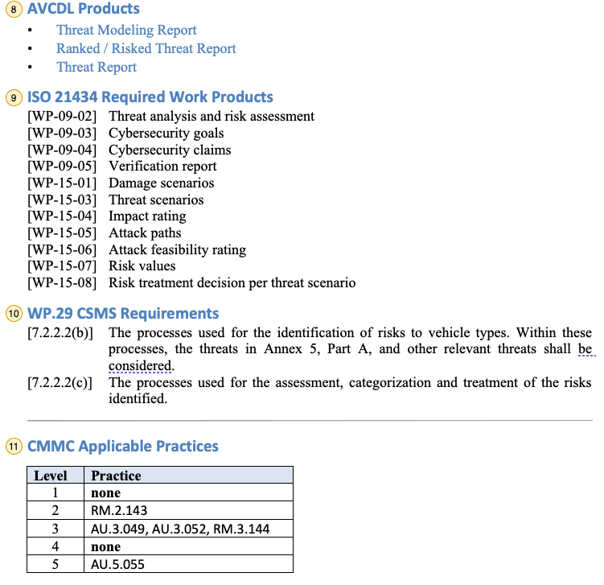
Phase Requirement Page Sample (2 of 2)
Item | Section | Description
 | Phase Products | Products created as a result of the activity. These are linked to secondary documents providing more specific information into the process needed to create them.
 | 21434 Work Products | Specific ISO 21434 work products / requirements satisfied by the activity.
 | WP.29 Requirements | Specific WP.29 CSMS (R155) requirements satisfied by the activity.
 | CMMC Practices | CMMC best practices applicable to the activity.
8
9
10
11

Slide 30
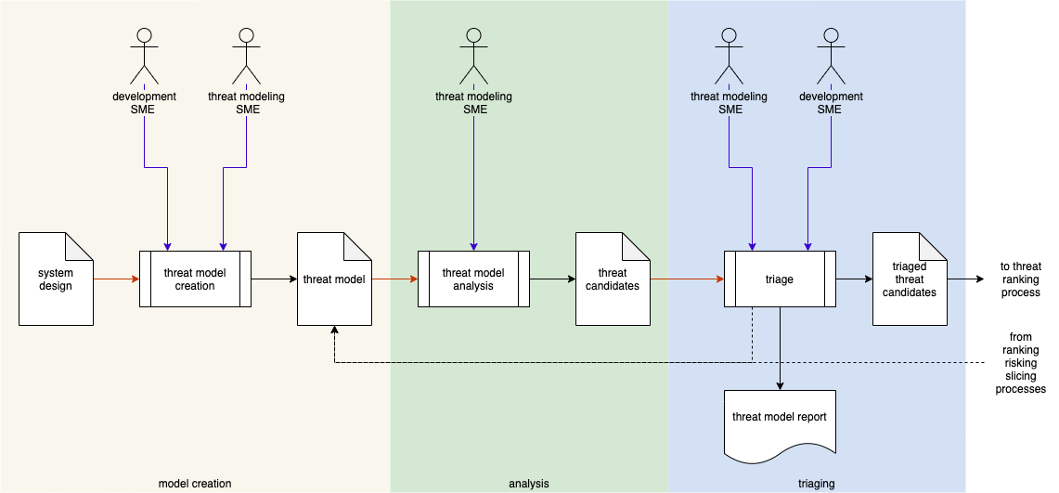
Process Flows

Slide 31
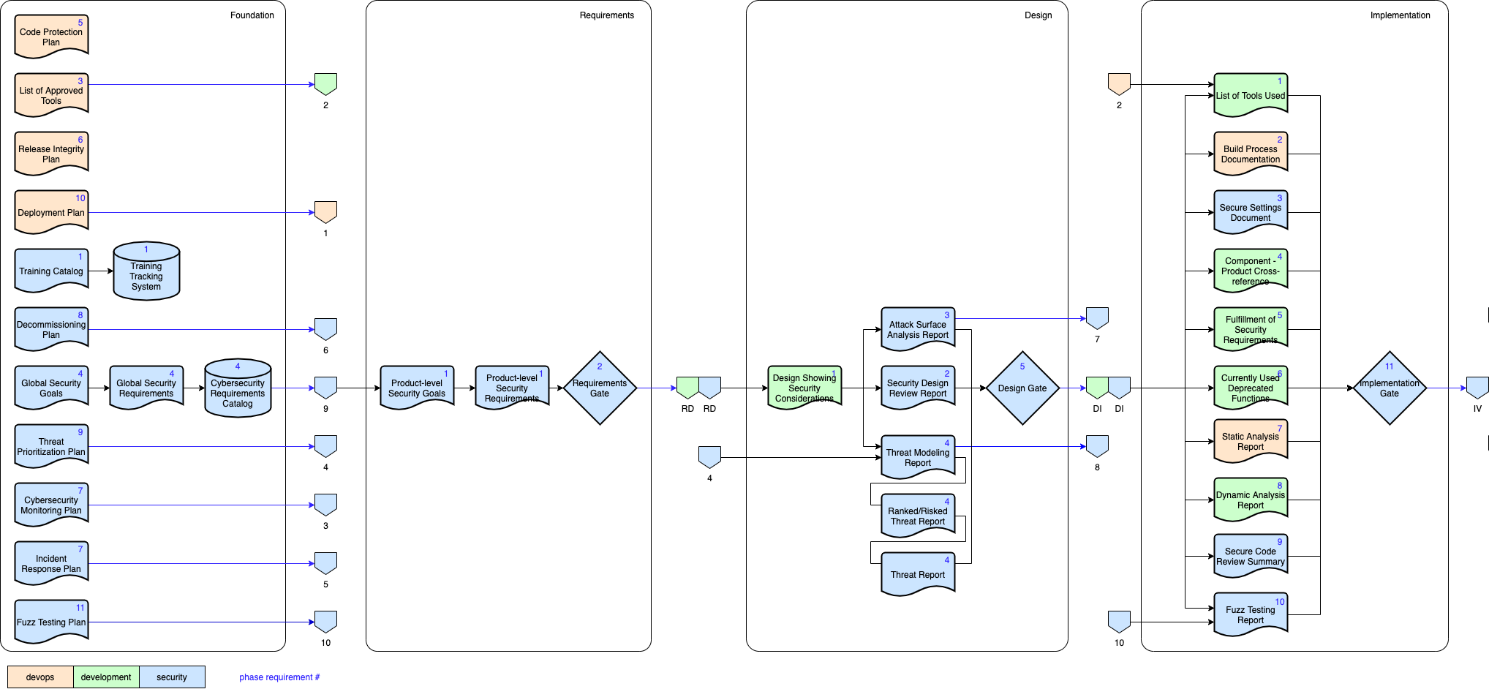
Traceability

Slide 32
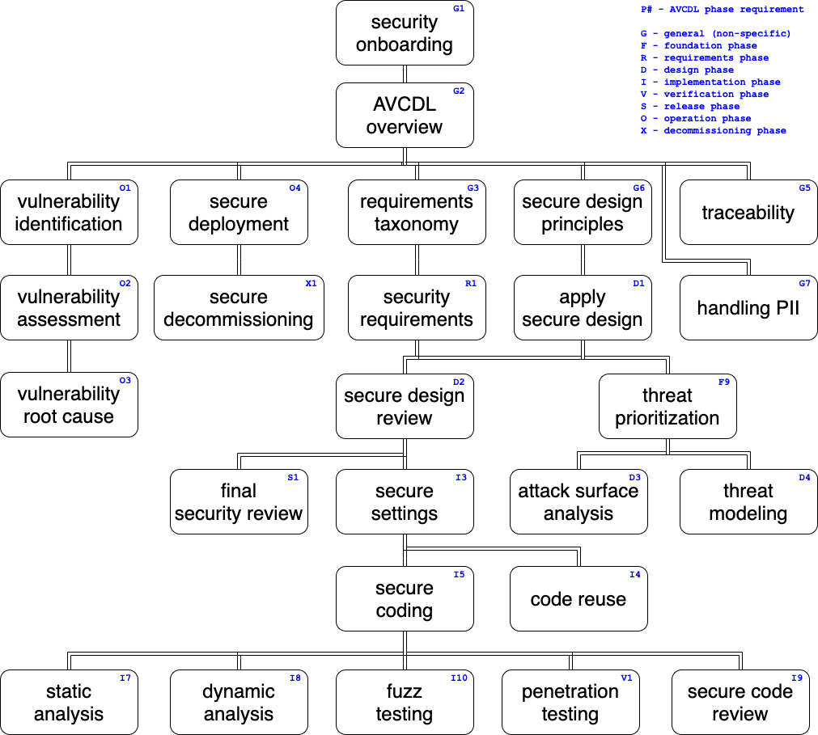
Training

Slide 33
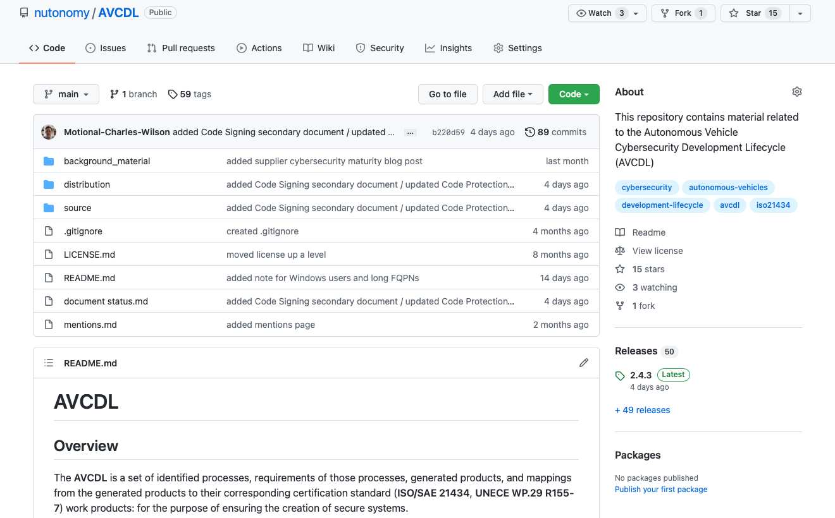
AVCDL on GitHub

Slide 34
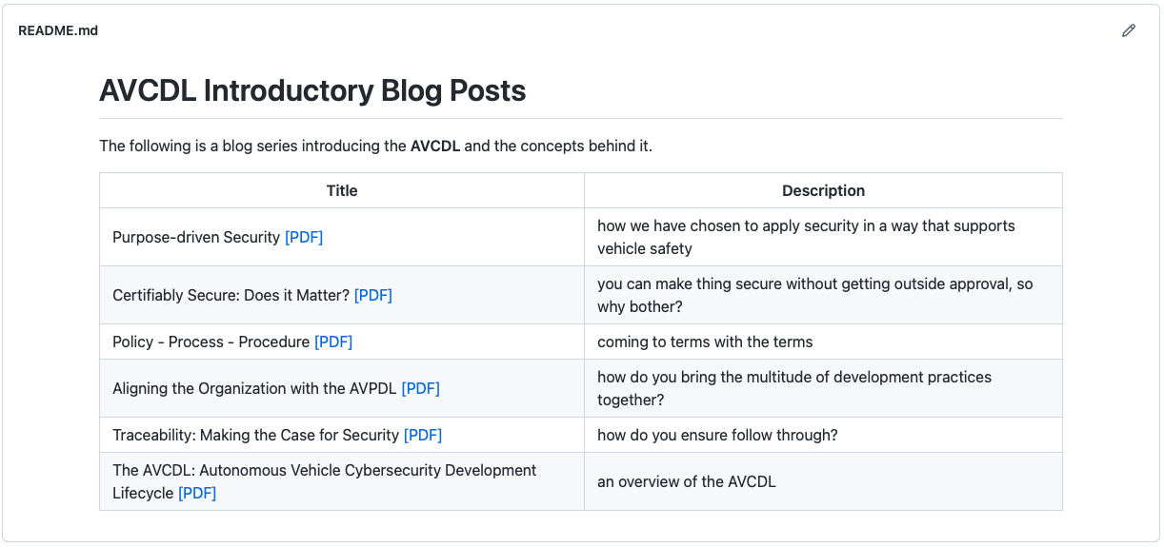
AVCDL Posts

Slide 35
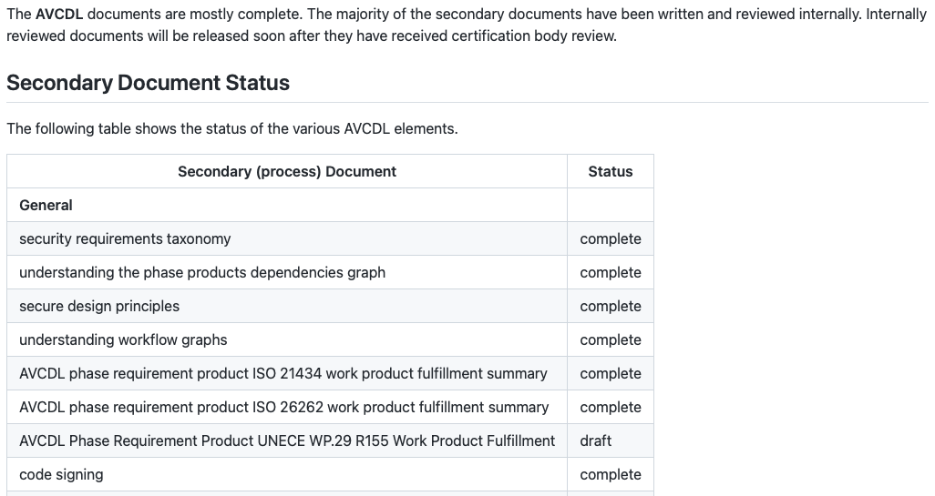
AVCDL Document Status

Slide 36
AVCDL Documents Available
https://github.com/nutonomy/AVCDL

Slide 37
AVCDL Documents Available – Primary Document
https://github.com/nutonomy/AVCDL

Slide 38
AVCDL Documents Available – Reference Material
https://github.com/nutonomy/AVCDL

Slide 39
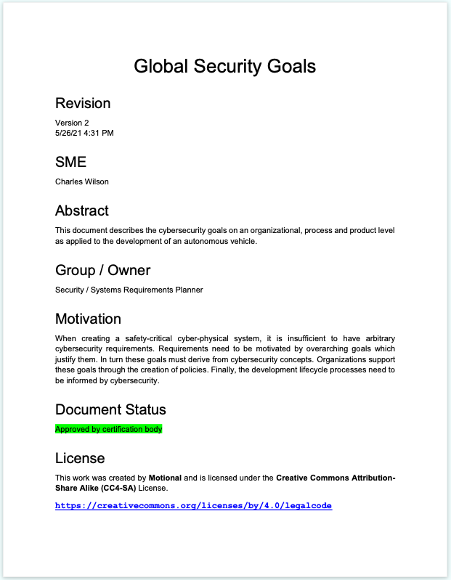
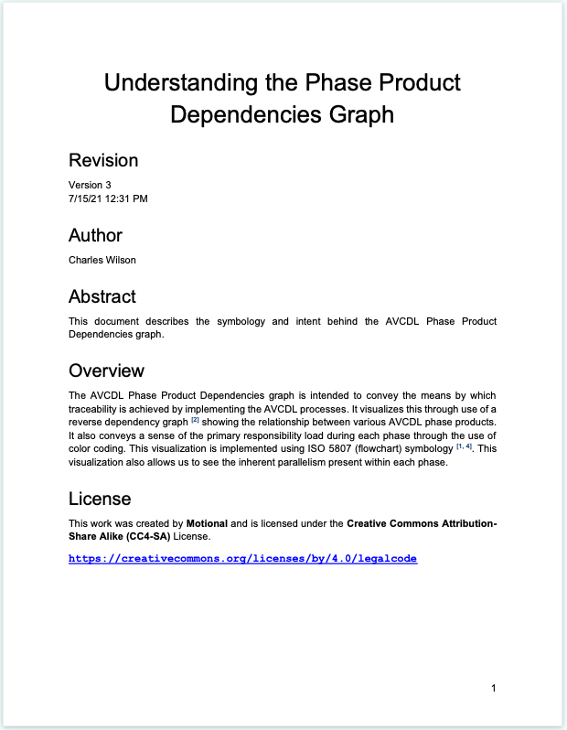
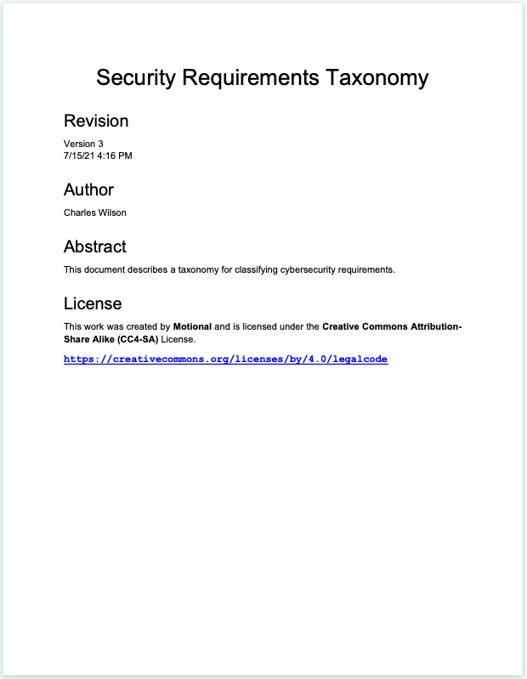
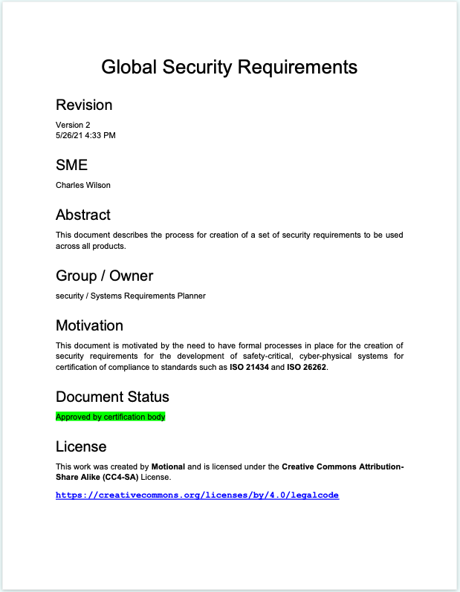
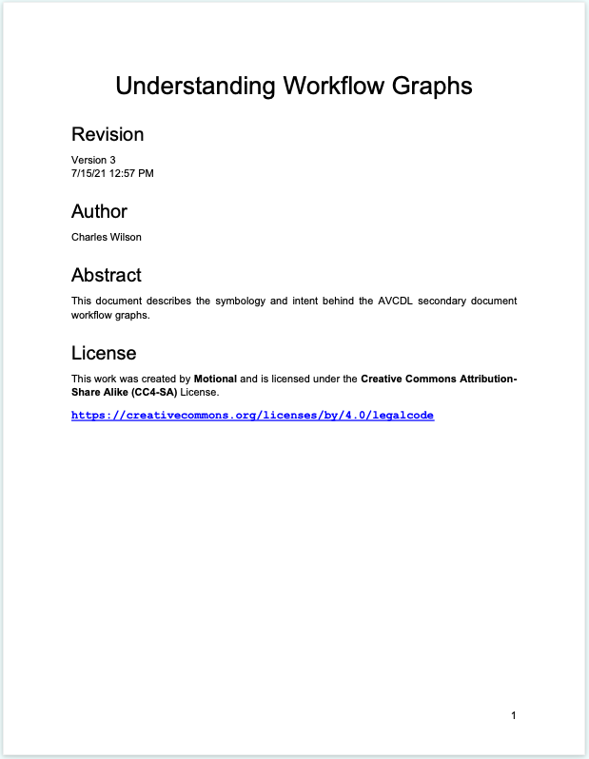
AVCDL Documents Available – Secondary Documents
https://github.com/nutonomy/AVCDL

Slide 40
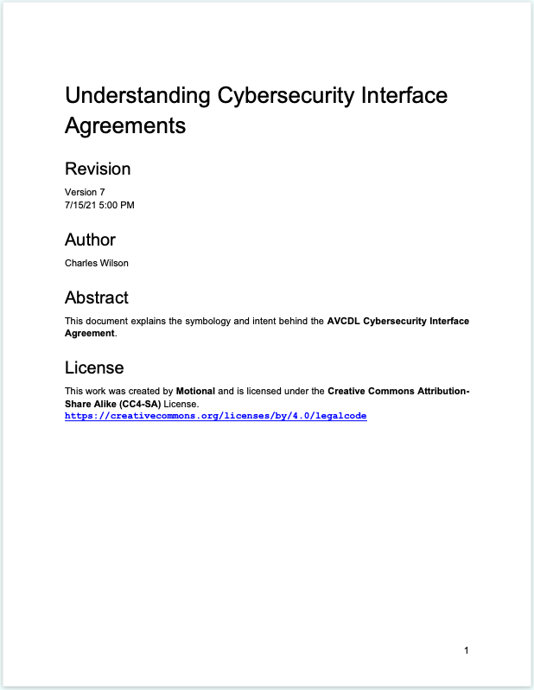
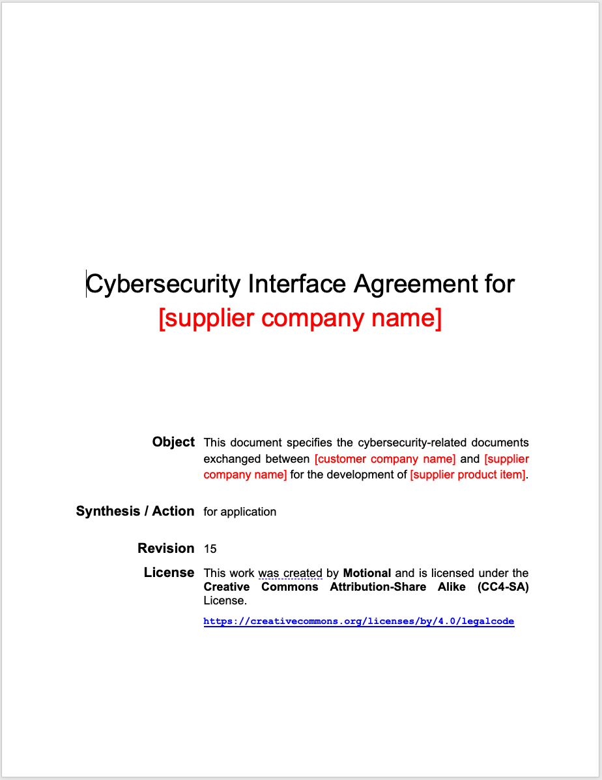
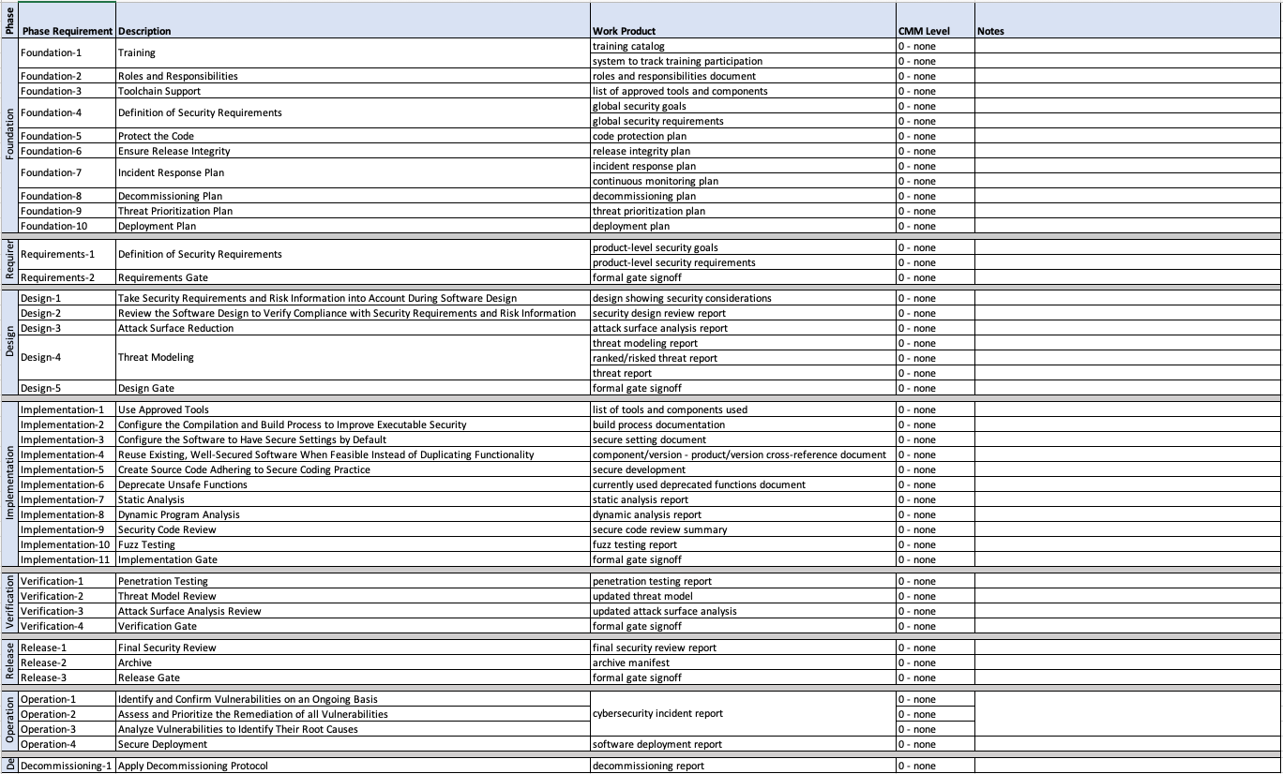
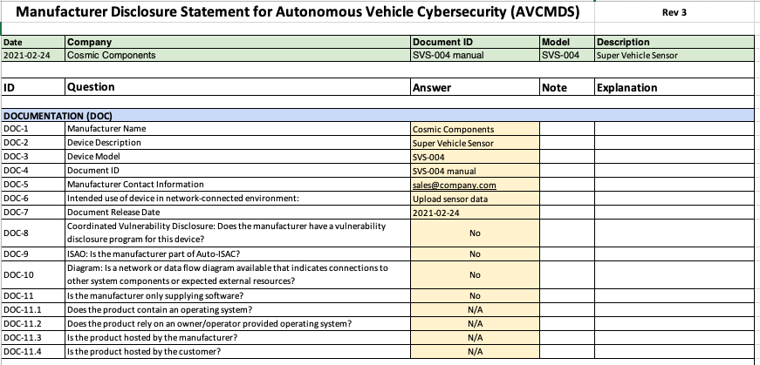
AVCDL Documents Available – Supplier Materials
https://github.com/nutonomy/AVCDL

Slide 41
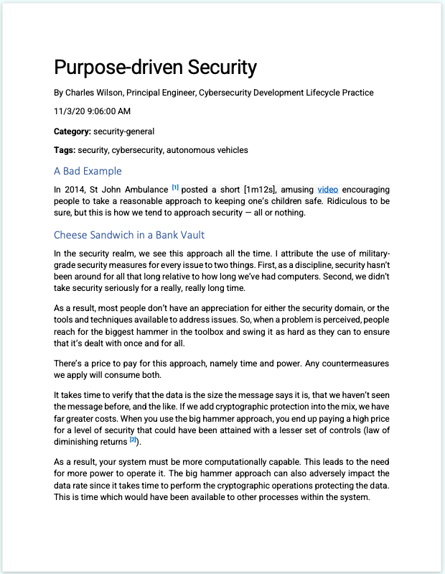
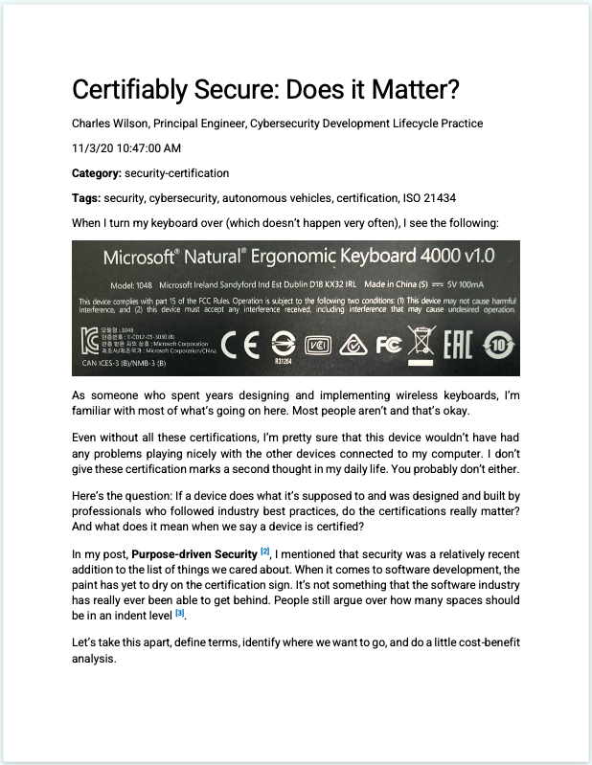
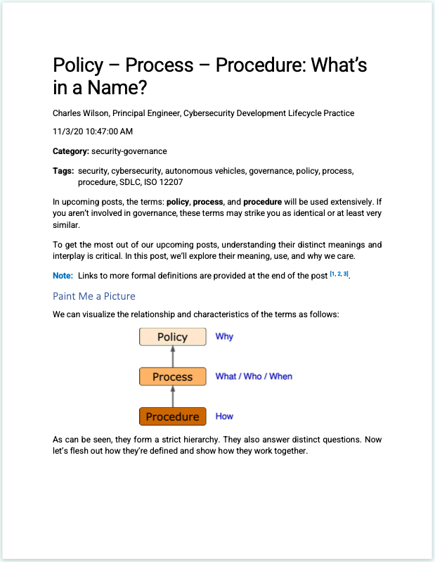
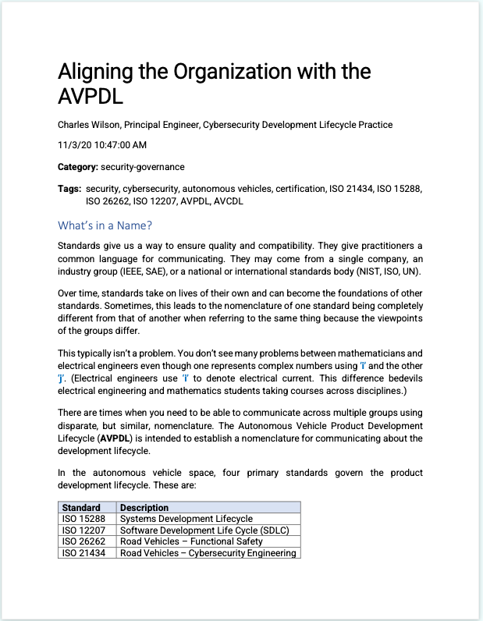
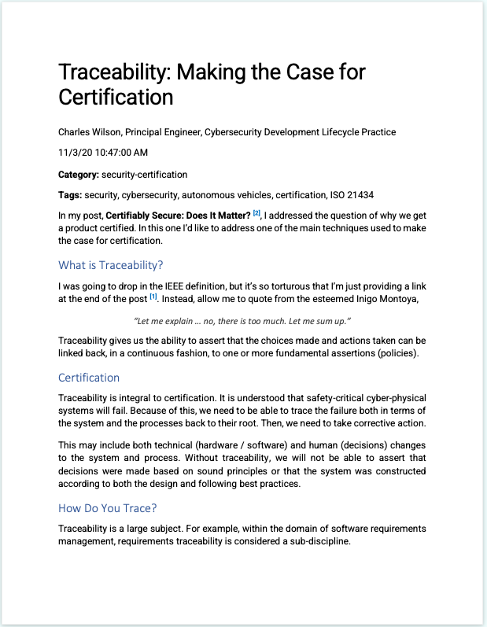
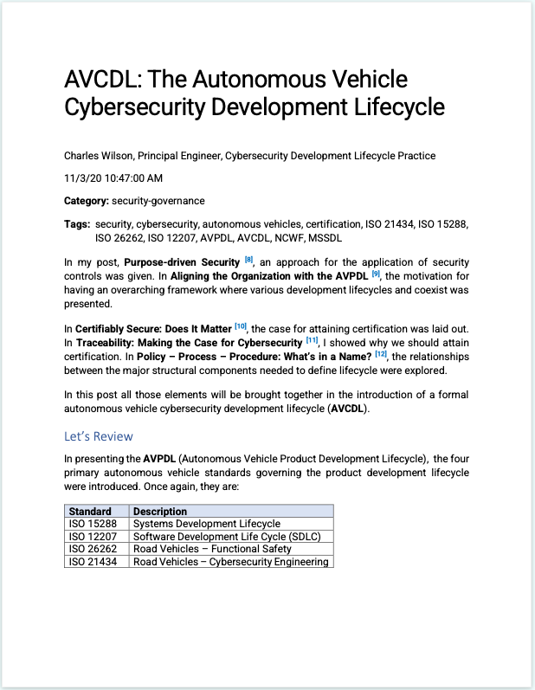
AVCDL Documents Available – Introductory Blog Posts
https://github.com/nutonomy/AVCDL

Slide 42
References (1 of 2)
Systems and software engineering - Software life cycle processes
https://en.wikipedia.org/wiki/ISO/IEC_12207
Systems and software engineering - System life cycle processes
https://en.wikipedia.org/wiki/ISO/IEC_15288
Road vehicles – Functional safety
https://en.wikipedia.org/wiki/ISO_26262
Secure Software Development for Autonomous Vehicles
https://www.sae.org/standards/content/iso/sae21434/
Microsoft Security Development Lifecycle (SDL) - simplified implementation
http://download.microsoft.com/download/F/7/D/F7D6B14F-0149-4FE8-A00F-0B9858404D85/Simplified Implementation of the SDL.doc
NHTSA Cybersecurity Best Practices for the Safety of Modern Vehicles
https://www.nhtsa.gov/staticfiles/nvs/pdf/812333_CybersecurityForModernVehicles.pdf
NICE Cybersecurity Workforce Framework (NCWF)
https://nvlpubs.nist.gov/nistpubs/SpecialPublications/NIST.SP.800-181r1.pdf

Slide 43
References (2 of 2)
Secure Software Development Framework (SSDF) https://nvlpubs.nist.gov/nistpubs/CSWP/NIST.CSWP.04232020.pdf
AVCDL (GitHub)
https://github.com/nutonomy/AVCDL
AVCDL Introductory Blog Post
https://github.com/nutonomy/AVCDL/tree/main/background_material/blog_posts
UN Regulation No. 155 - Cyber security and cyber security management system
https://unece.org/transport/documents/2021/03/standards/un-regulation-no-155-cyber-security-and-cyber-security

